Slide 1

LIBRARY MANAGEMENT
K VENKAT NAVEEN KUMAR
1009-17-861-095
BCA III Year
Guide : G .SAHAJA
NIZAM COLLEGE

Slide 2
Contents
S NO. | Description
1) | Screenshots of execution of project
2) | Test cases
3) | Conclusion
4) | Future Work
5) | References

Slide 3
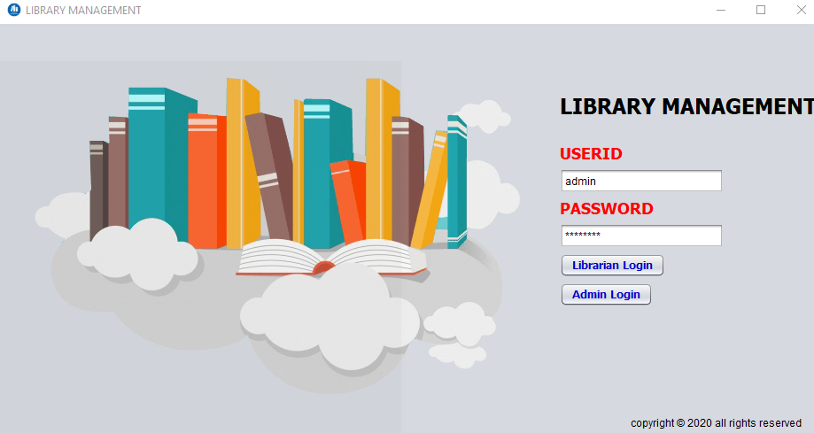
Execution of the Project:
Login Frame

Slide 4
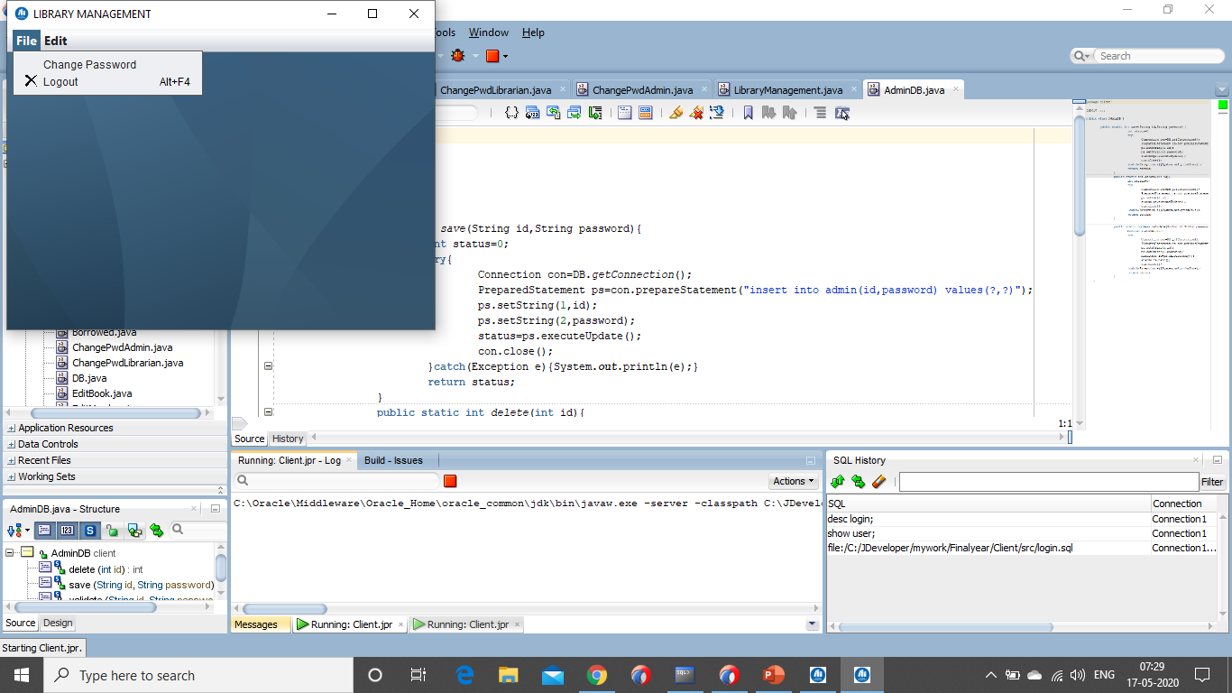
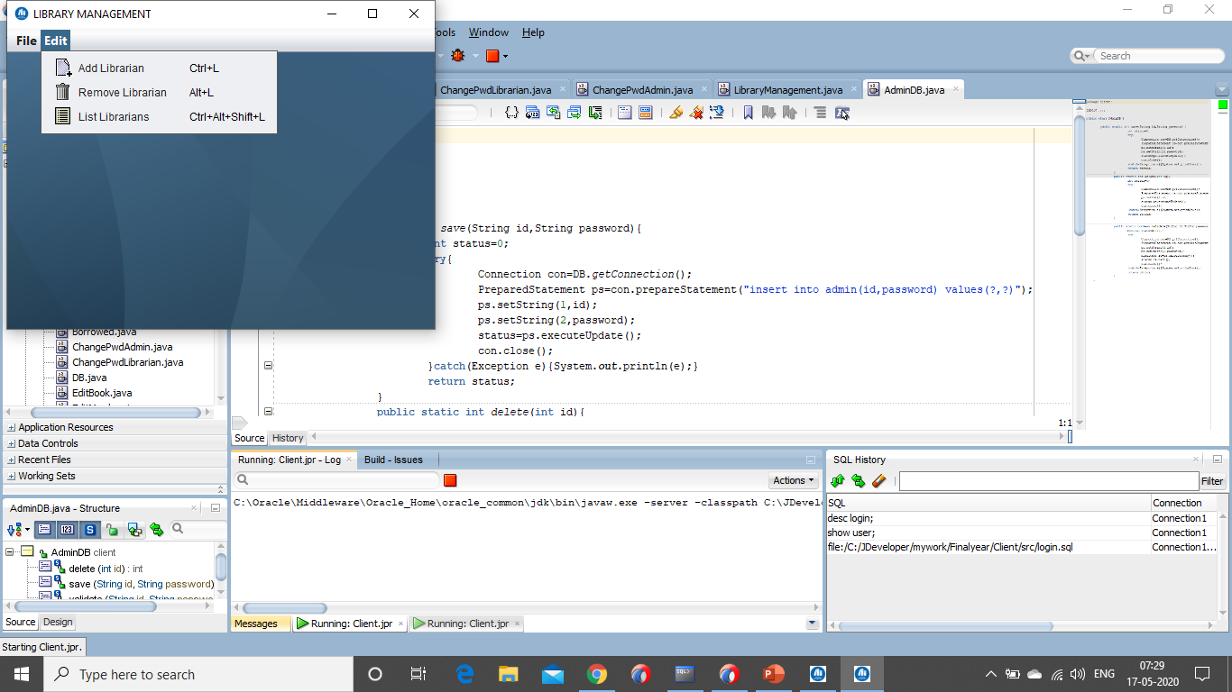
Admin Frame

Slide 5
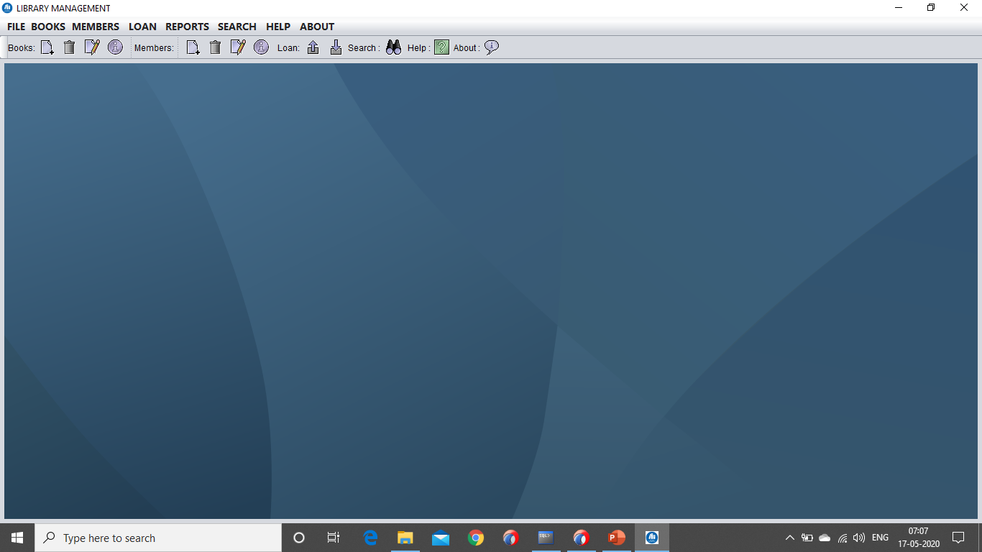
Librarian Frame

Slide 6
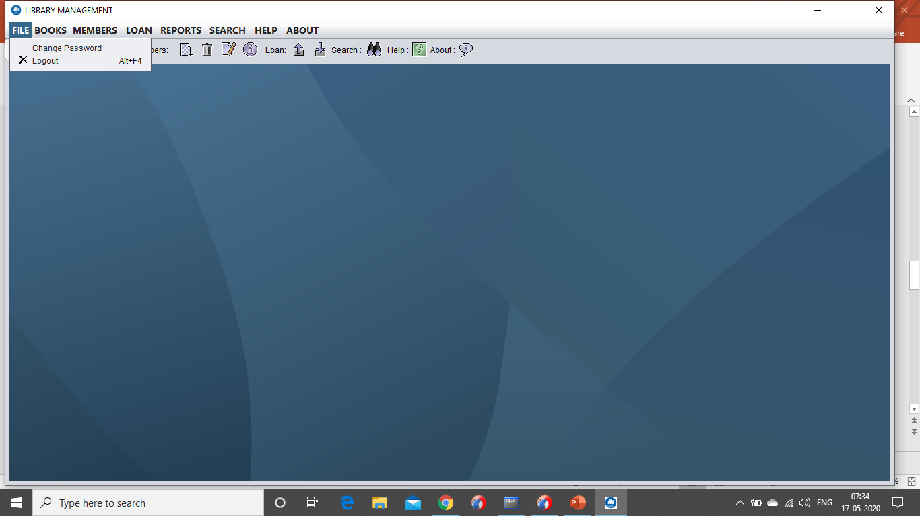
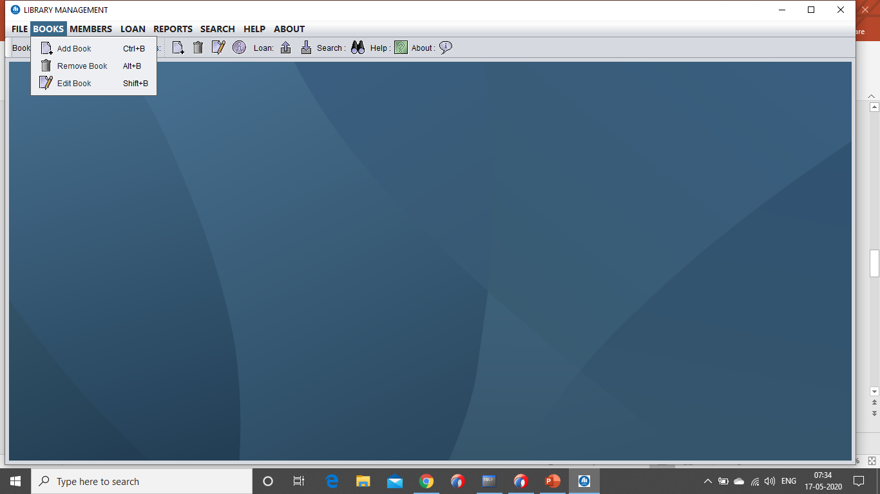
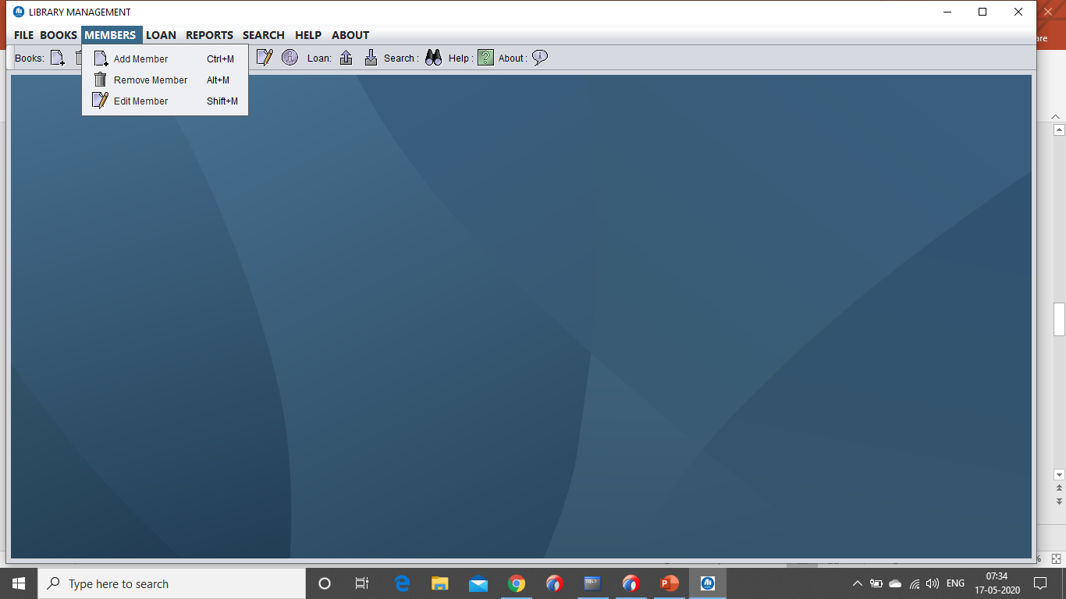
Librarian Frame

Slide 7
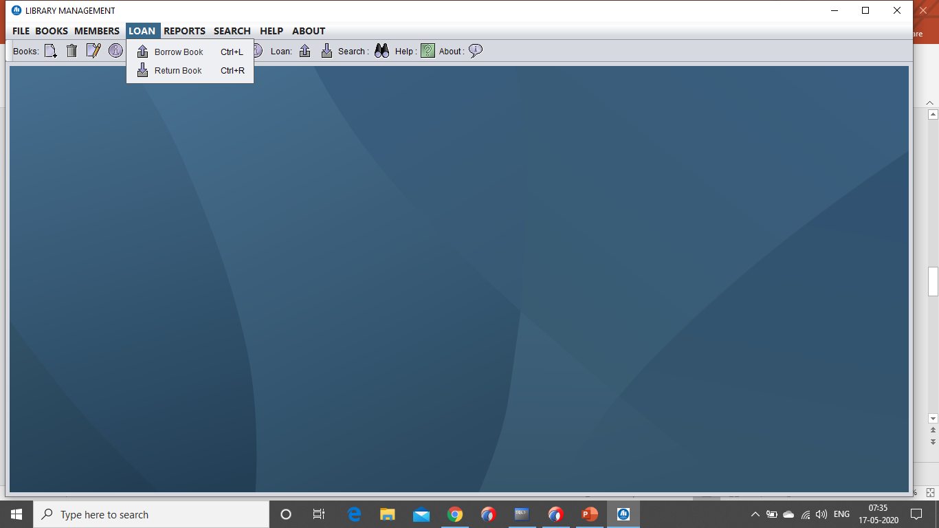
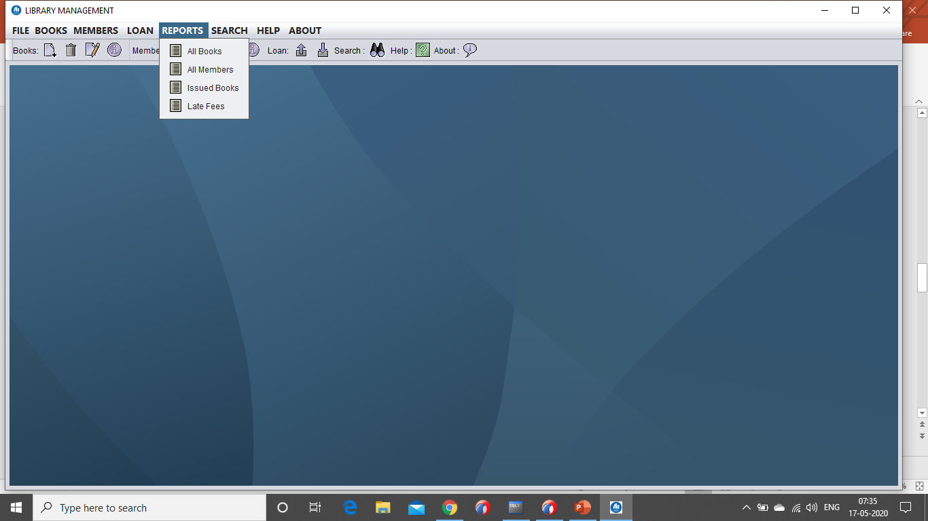
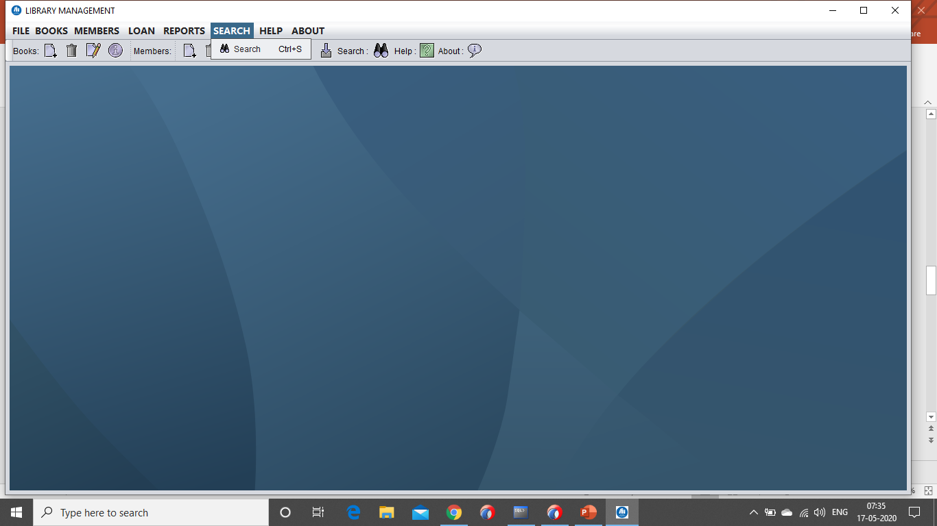
Librarian Frame

Slide 8
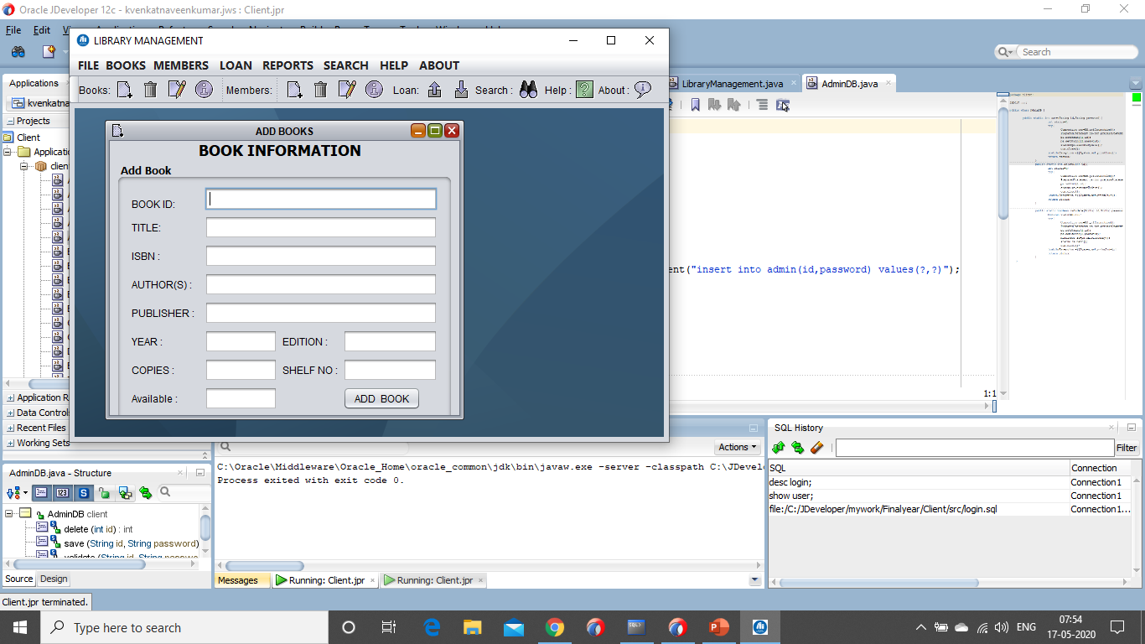
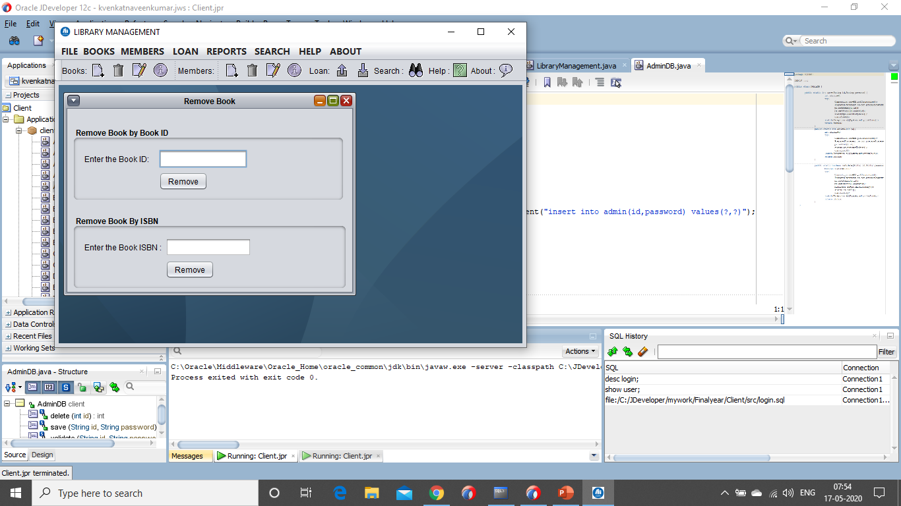
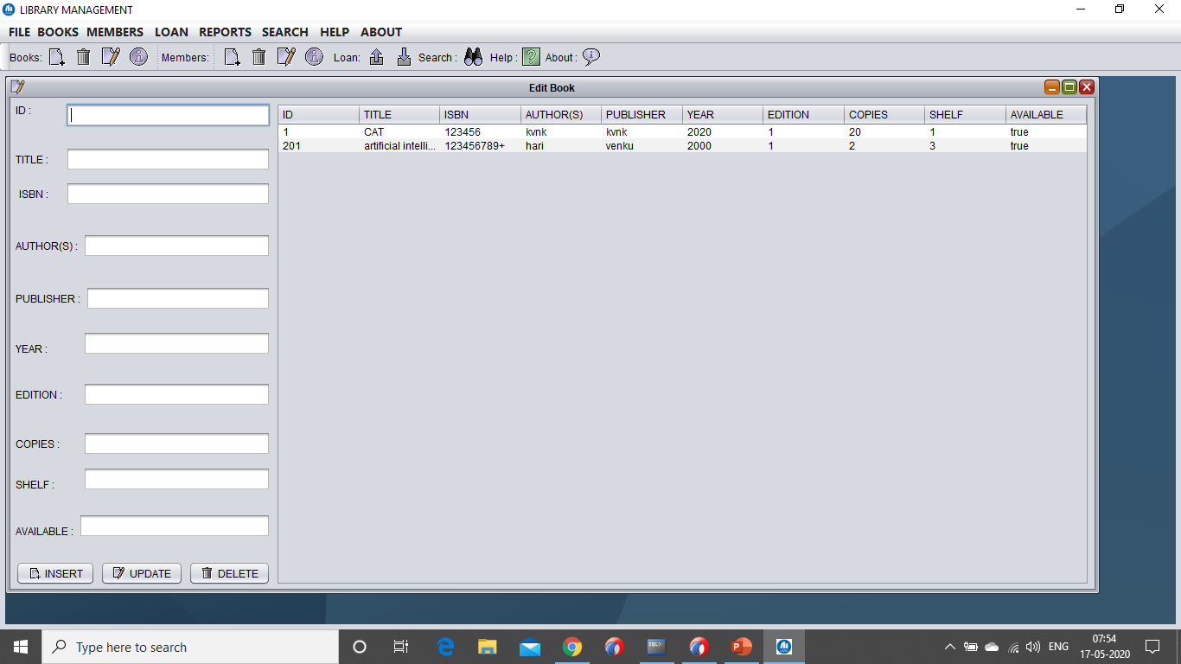
Books Frames

Slide 9
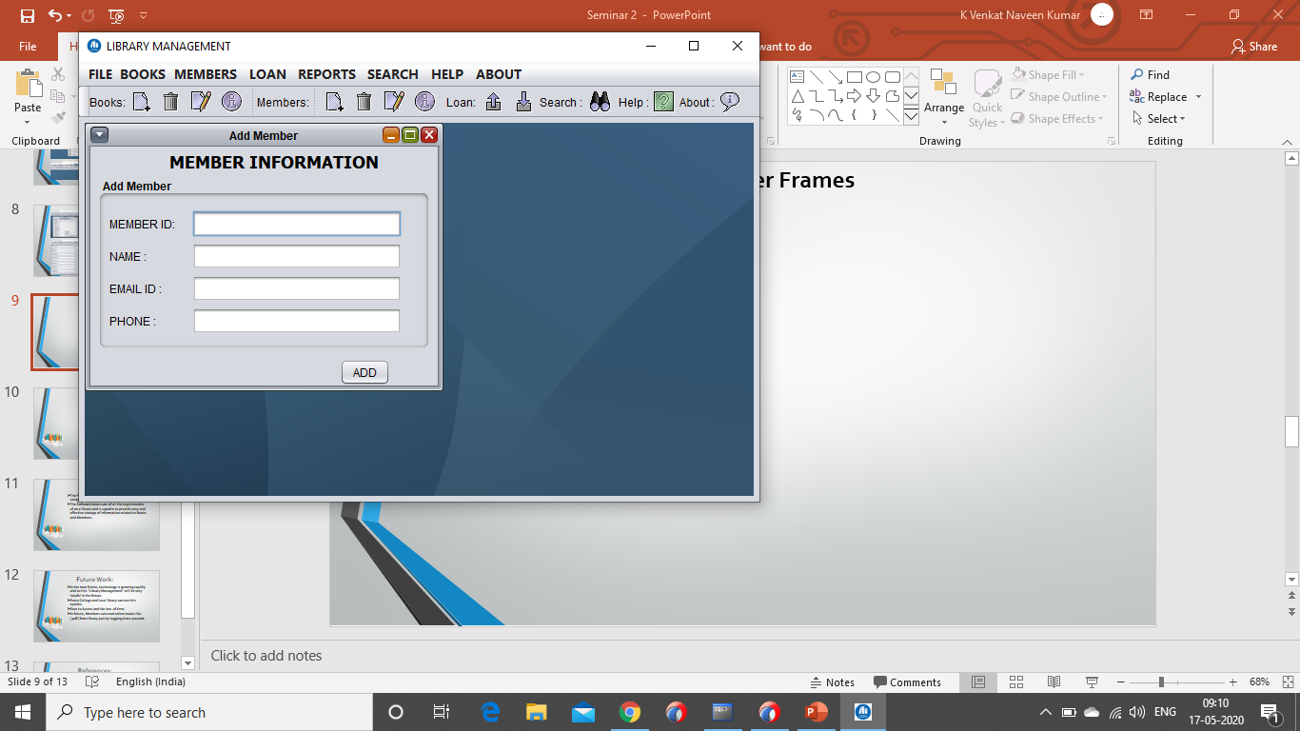
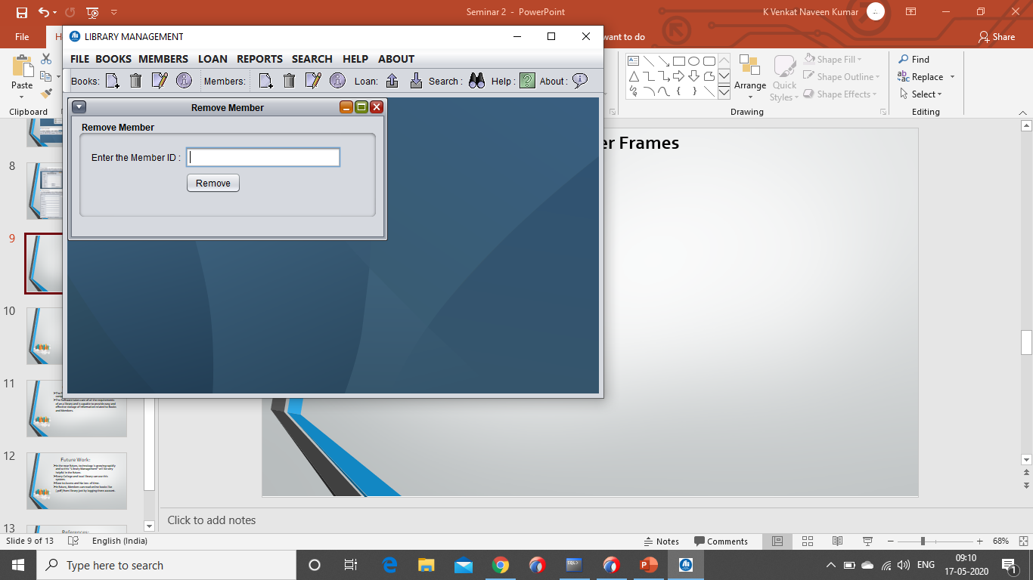
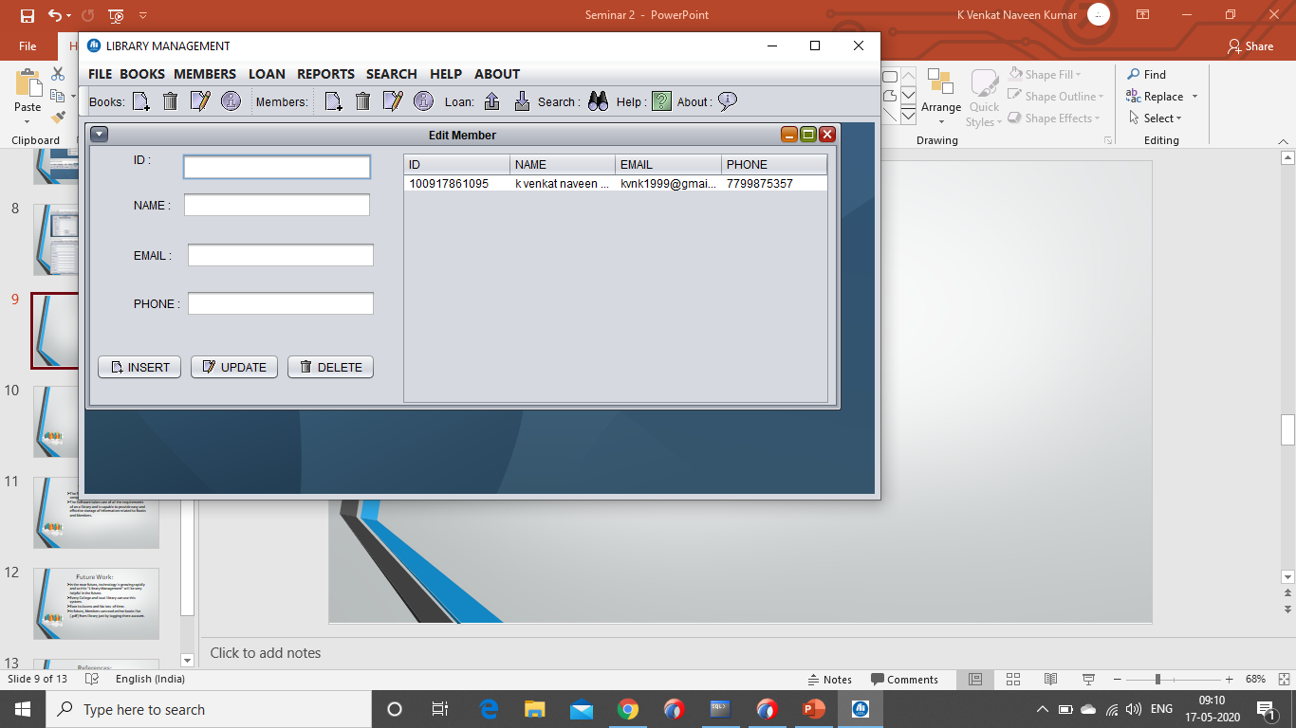
Member Frames

Slide 10
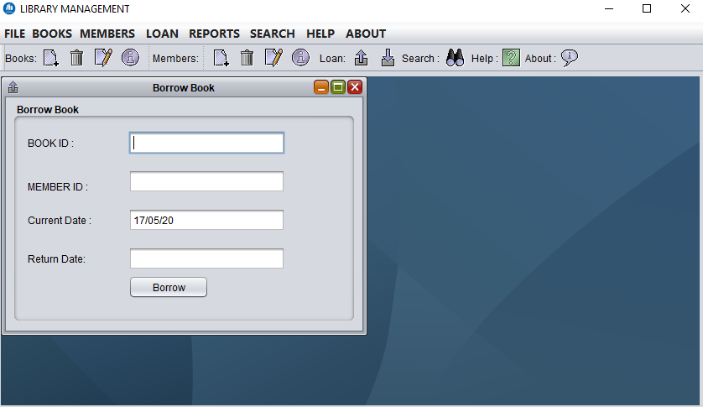
Borrow Book

Slide 11
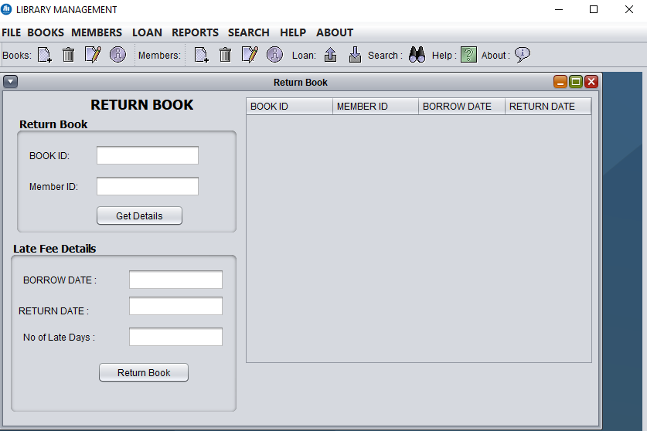
Return Book

Slide 12
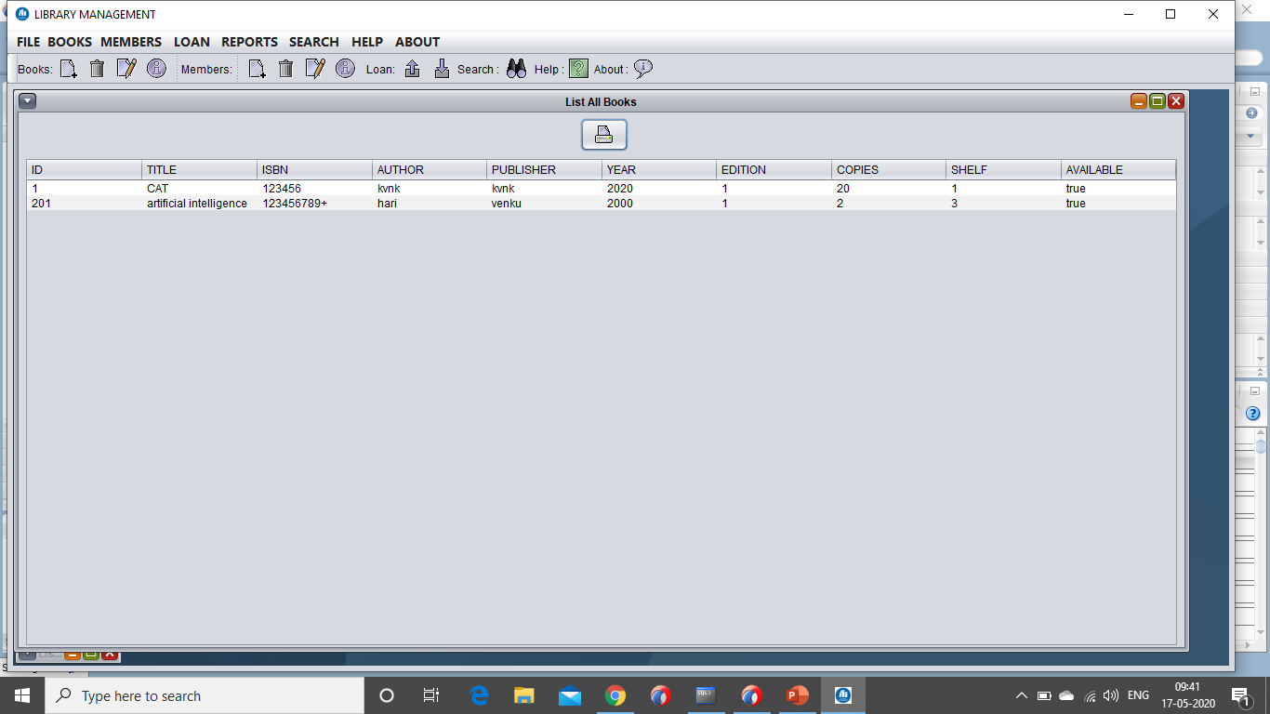
List of All Books

Slide 13
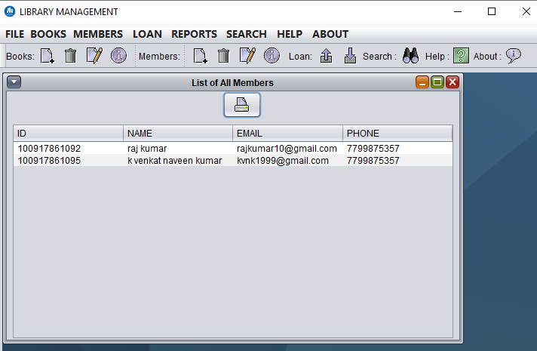
List of All Members

Slide 14
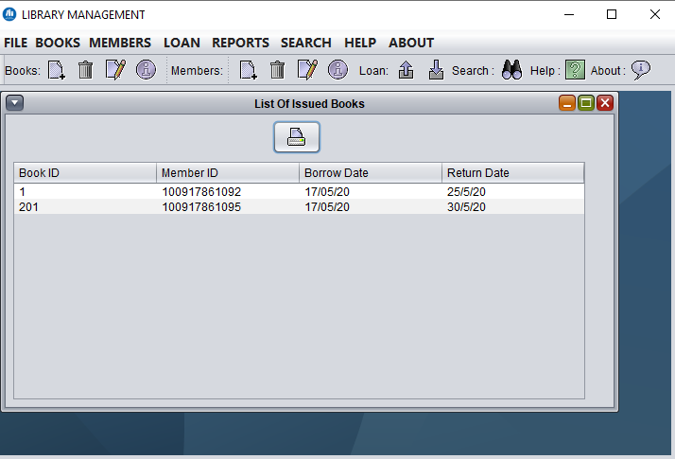
List of Issued Books

Slide 15
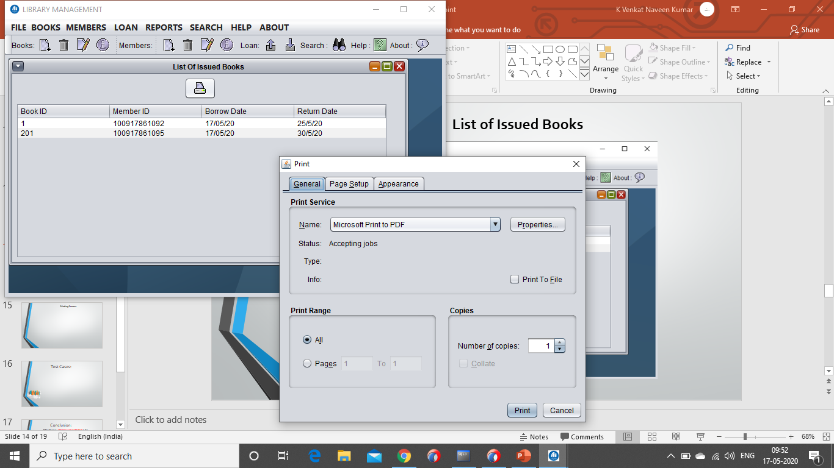
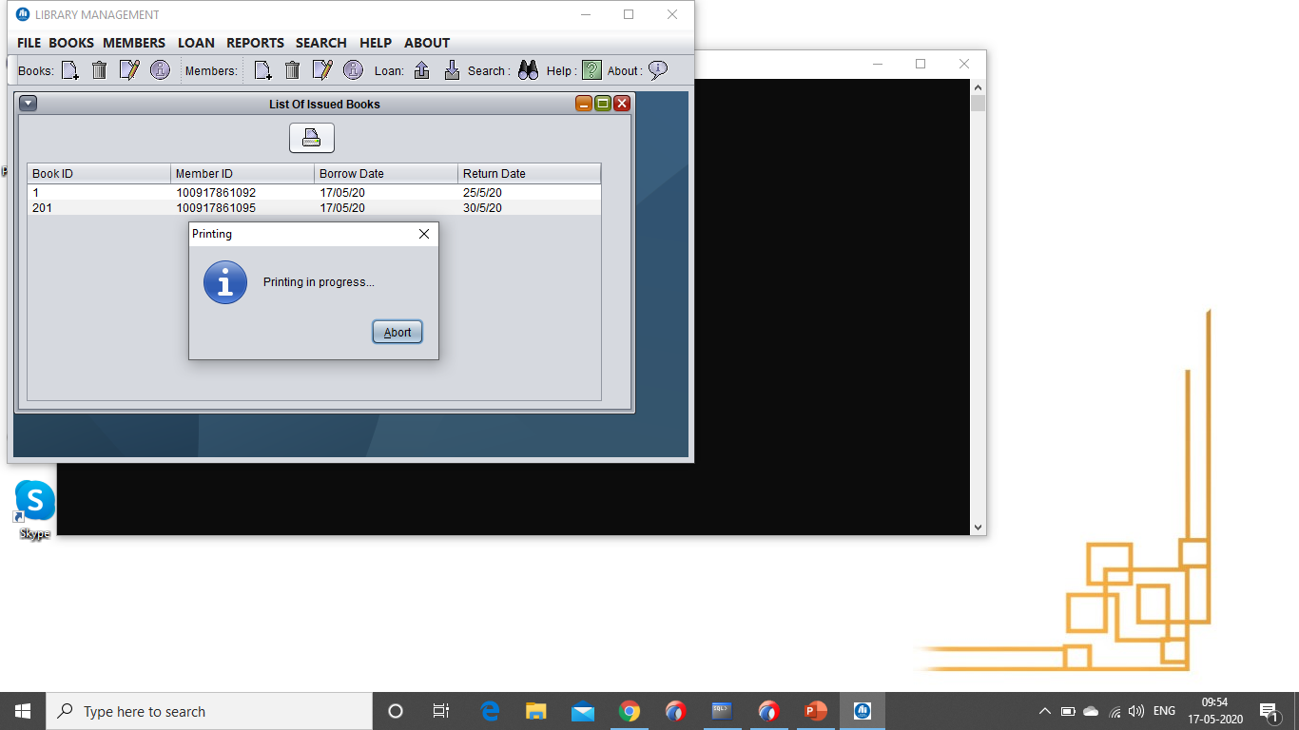
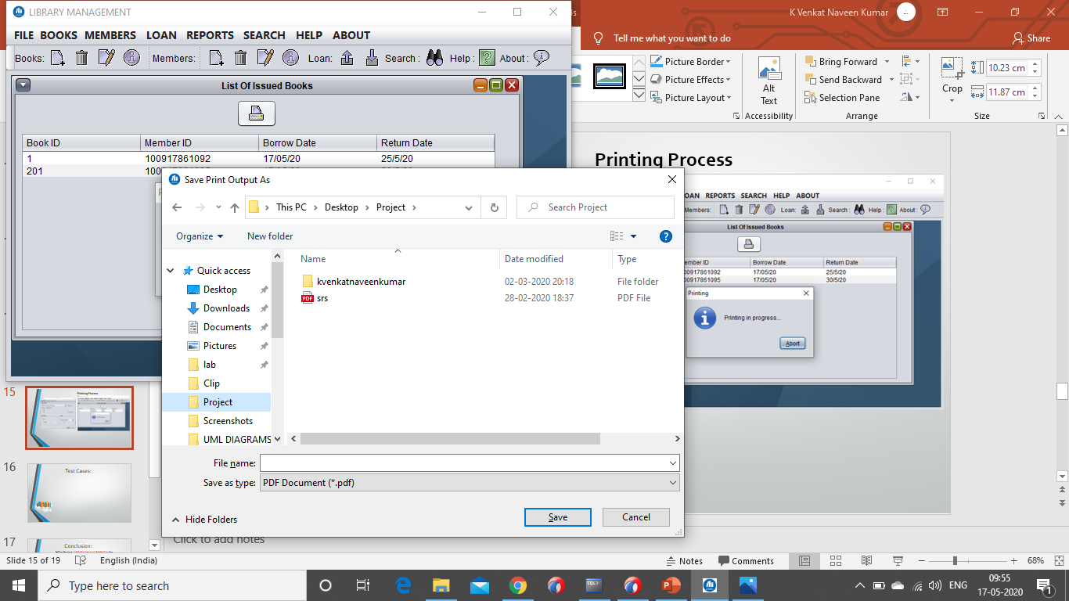
Printing Process

Slide 16
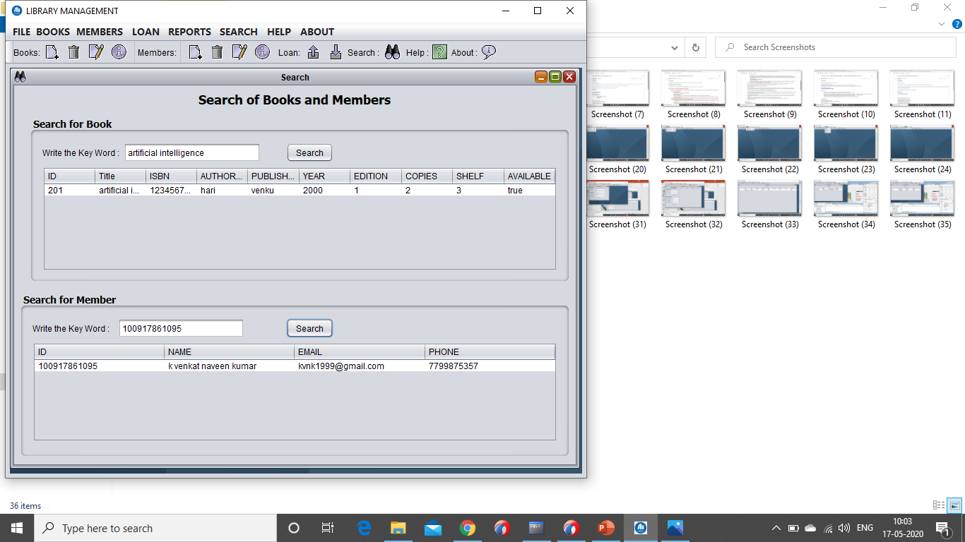
Search for Members and Books

Slide 17
Test Cases:
Template for Test Case
Guidelines for Test Cases:
GUI Test Cases:
Total no features that need to be check
Look and feel
Look for Default values if at all any(date & Time, if at all any require)
Look for spell Check
Test Case No | Description | Expected Value | Actual Value | Result

Slide 18
Test Cases:
Example for GUI Test Cases:
Test Case No | Description | Expected Value | Actual Value | Result
1) | Check for all features in the screen | The Screen must contain all the features
2) | Check for Alignment of the Objects as per the requirements | The Alignment should be in proper way

Slide 19
Test Cases:
2. Positive Test Cases:
Positive flow of the functionality must be considered
Inputs must be used for testing
Must have the positive perception to verify whether the requirements are justified.
Test Case No | Description | Expected Value | Actual Value | Result
1) | Check for the date Time Auto Display | The date and time of the system must be displayed
2) | Enter the valid Roll no into Member field | It should accept

Slide 20
Test Cases:
3. Negative Test Cases:
Must have negative perception
Invalid inputs must be used for test.
Test Case No | Description | Expected Value | Actual Value | Result
1) | Try to modify information in date and time | Modification should not allowed
2) | Enter invalid username and password, click login | It should not accept invalid date , Error should be shown

Slide 21
Conclusion:
The Project LIBRARY MANAGEMENT is for computerizing the working in a library.
The Software takes care of all the requirements of an a library and is capable to provide easy and effective storage of information related to Books and Members.

Slide 22
Future Work:
In the near future, technology is growing rapidly and so this “Library Management” will be very helpful in the future.
Every College and local library can use this system.
Ease to Access and No loss of time.
In future, Members can read online books like [.pdf] from library just by logging there account.

Slide 23
References:
https://en.wikipedia.org
https://www.tutorialspoint.com/sdlc/sdlc_agile_model.htm
JDBC 4.2, Servlet 3.1, and JSP 2.3 Includes JSF 2.2 and Design Patterns, Black Book- Santosh Kumar
Java Complete Reference - Herbert Schildt.
https://www.javatpoint.com/java-tutorial

Slide 24
THANK YOU

